Slide 1
Lab3 实验讲解补充

Slide 2
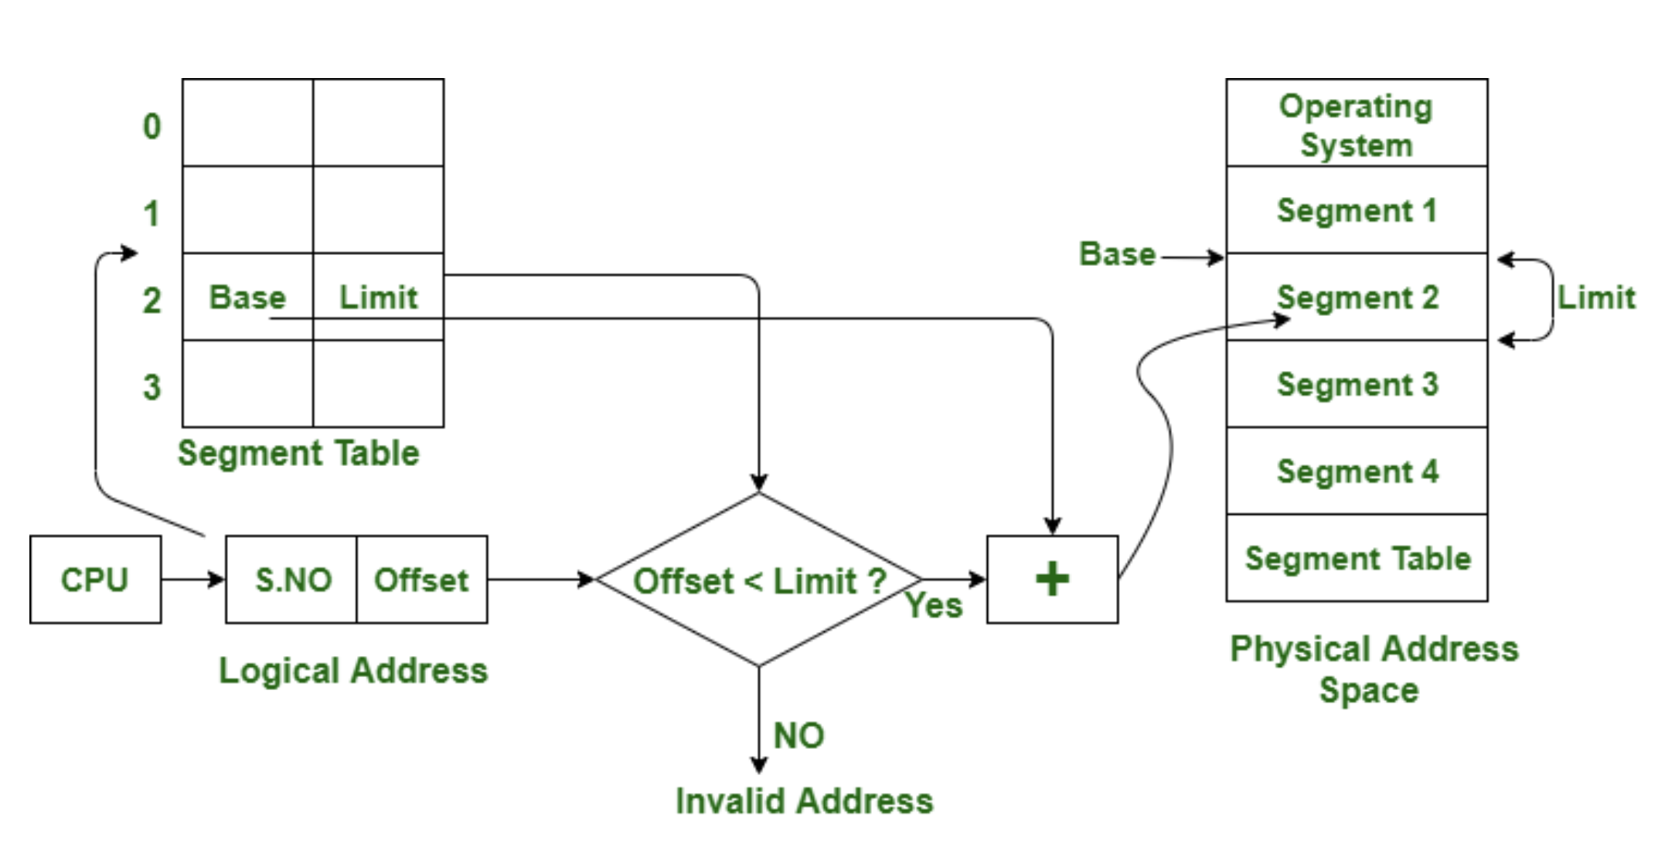
Segmentation & Memory Fragmentation
Before Page Table:
Fixed-size Segmentation
internal fragmentation
Dynamic-size Segmentation
external fragmentation
continuous virtual address
map to continuous physical address
high cost for garbage collection (GC)
no need to map to continuous physical address?

Slide 3
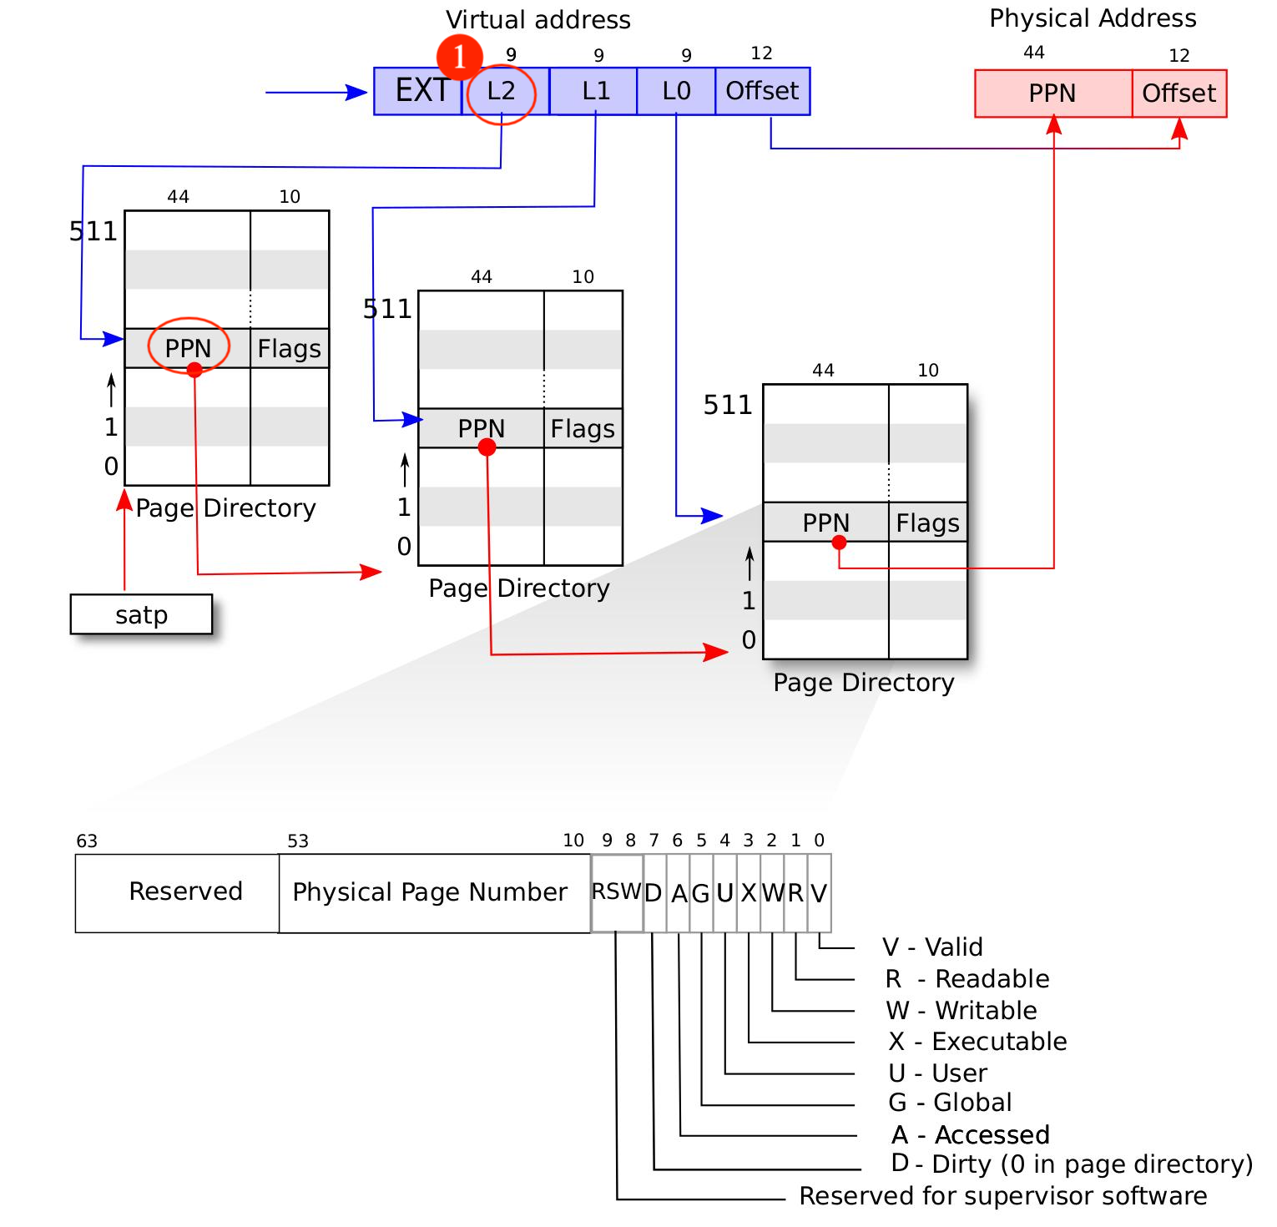
How to Translate VA to PA
0. PPN_2 <- satp
1. PPN_1 <- PPN_2 [ L2_index ]
2. PPN_0 <- PPN_1 [ L1_index ]
3. PTE <- PPN_0 [ L0_index ]
4. PA <- {PTE, Offset}

Slide 4
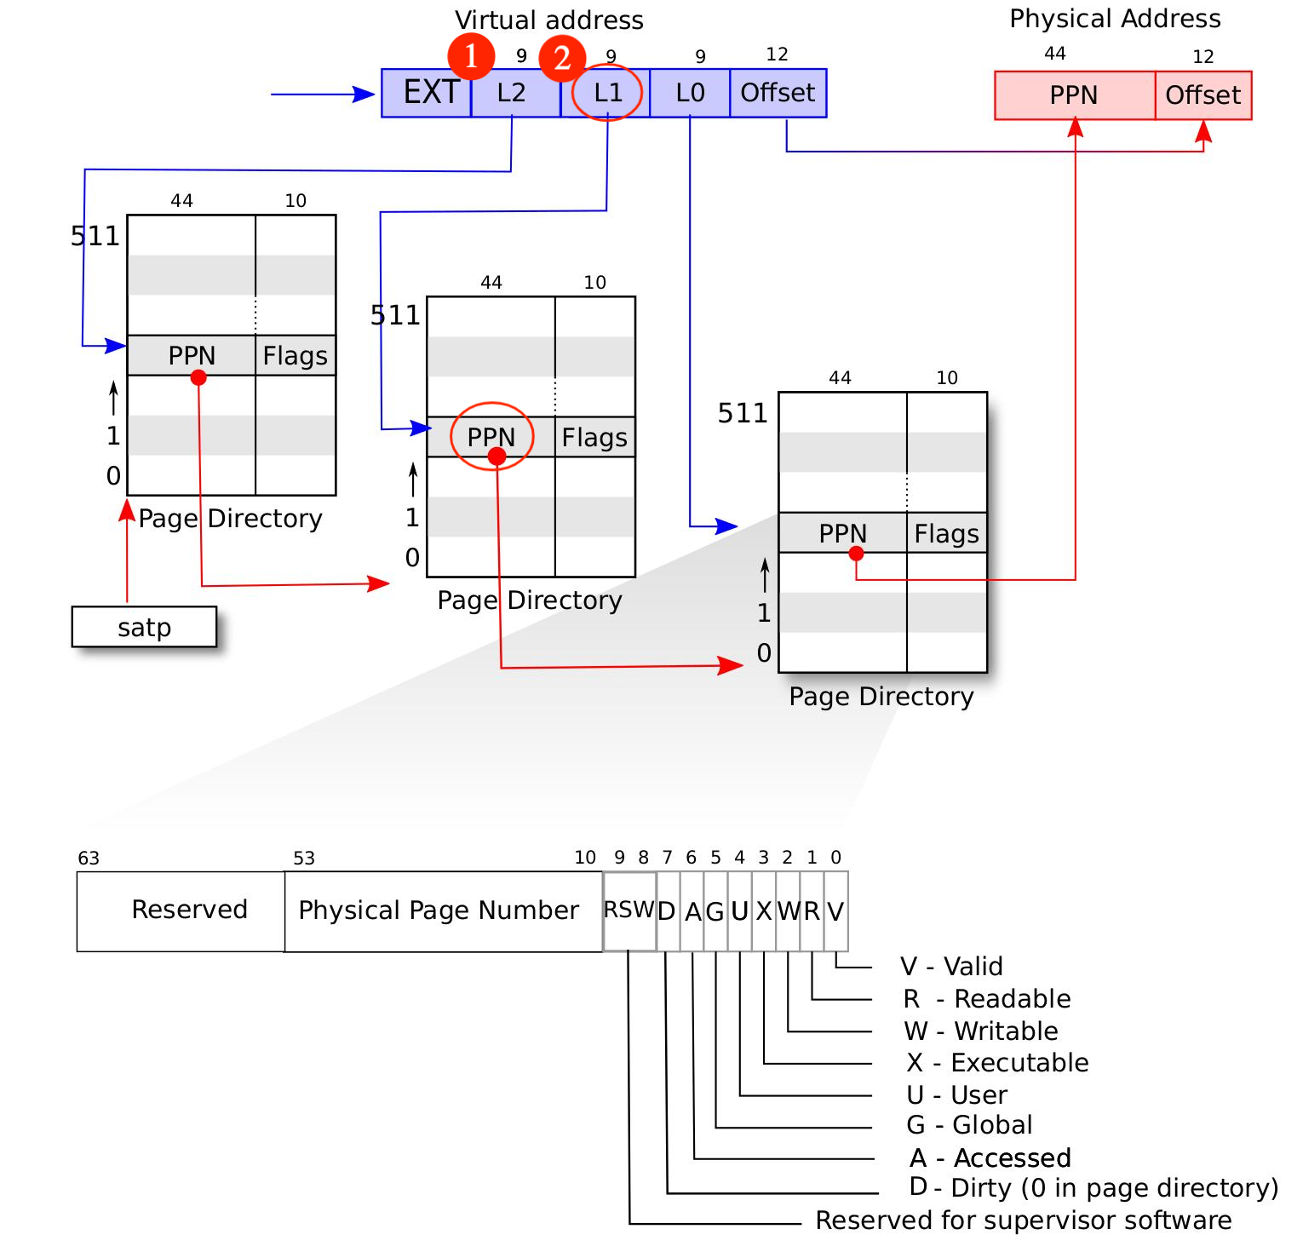
How to Translate VA to PA
0. PPN_2 <- satp
1. PPN_1 <- PPN_2 [ L2_index ]
2. PPN_0 <- PPN_1 [ L1_index ]
3. PTE <- PPN_0 [ L0_index ]
4. PA <- {PTE, Offset}

Slide 5
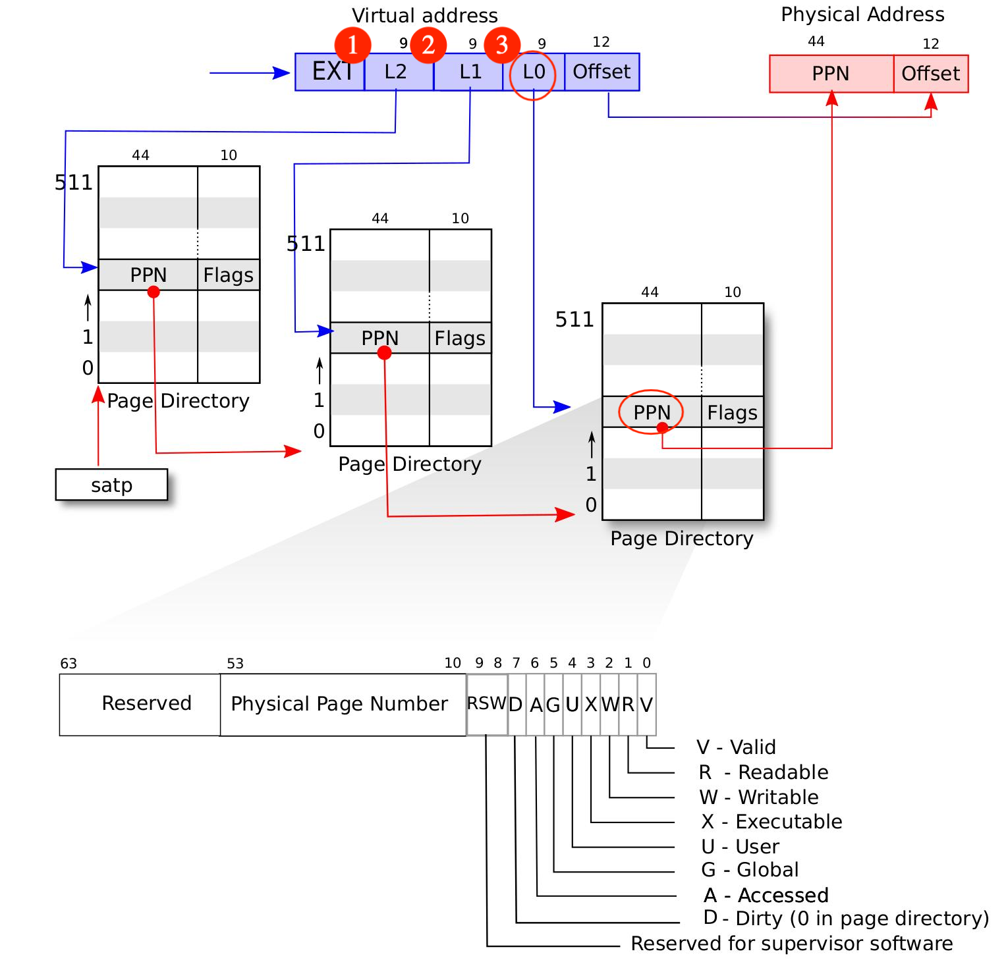
How to Translate VA to PA
0. PPN_2 <- satp
1. PPN_1 <- PPN_2 [ L2_index ]
2. PPN_0 <- PPN_1 [ L1_index ]
3. PTE <- PPN_0 [ L0_index ]
4. PA <- {PTE, Offset}

Slide 6
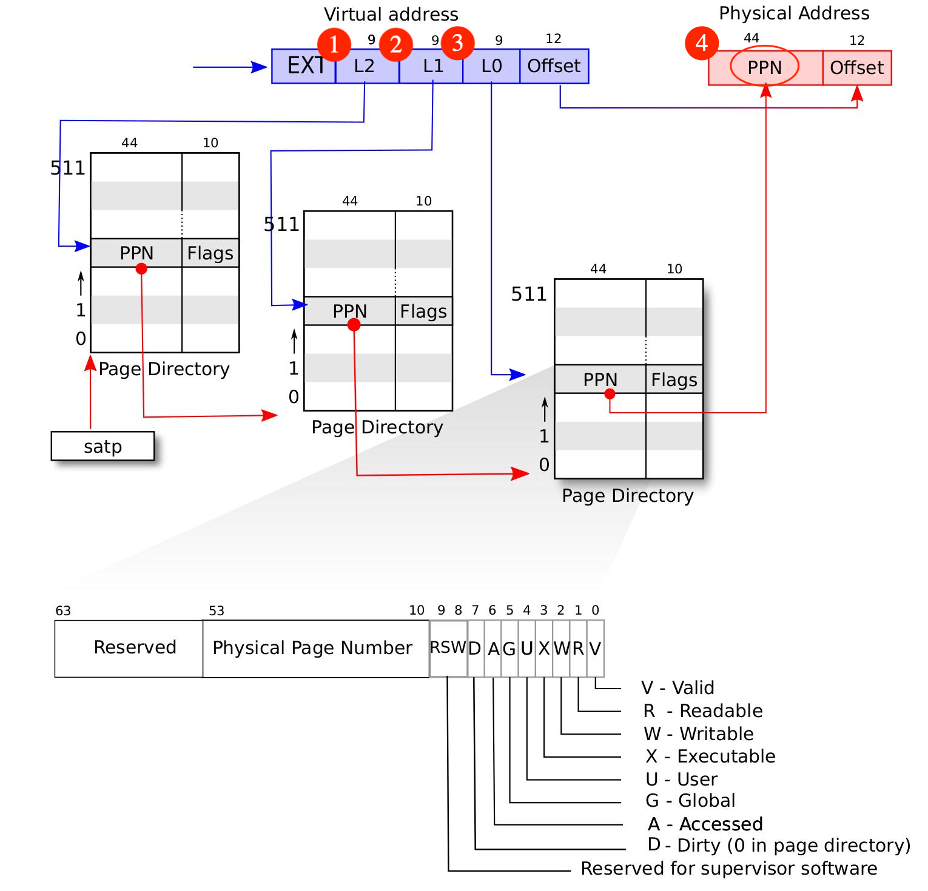
How to Translate VA to PA
0. PPN_2 <- satp
1. PPN_1 <- PPN_2 [ L2_index ]
2. PPN_0 <- PPN_1 [ L1_index ]
3. PTE <- PPN_0 [ L0_index ]
4. PA <- {PTE, Offset}
（伪代码请选择性借鉴，防止查重代码重合太高）

Slide 7
What to do in our lab3?
set up page table
讲人话就是，按照页粒度，把所有的 virtual address 尝试按照 sv39 的流程翻译成 physical address，然后在页表里填上相关的 PTE

Slide 8
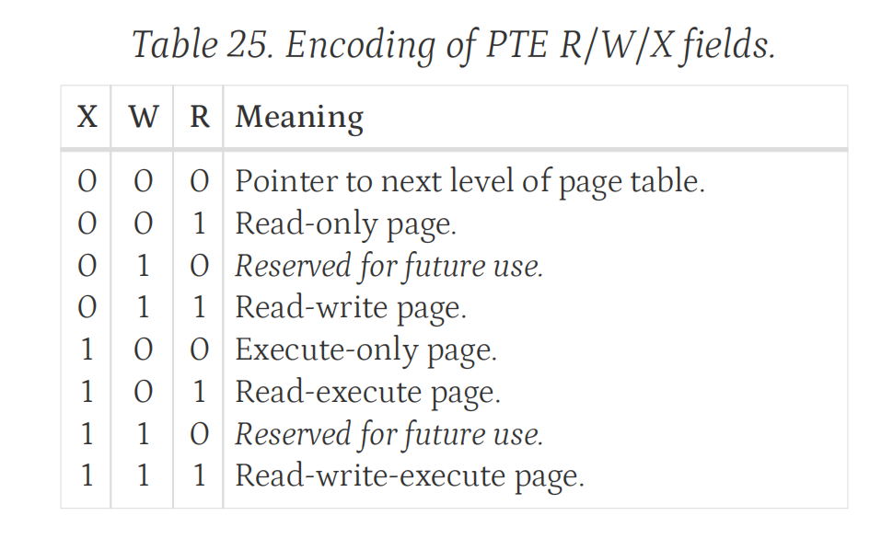
Huge Page (e.t. 2MB, 1 GB)
How MMU figure out whether a page is a HUGE PAGE?
reference: riscv64 spec page 106

